Slide 1
Developing a Research Proposal
Maryann Hardy
PhD, MSc, BSc (Hons), DCR(R)
Professor of Radiography & Imaging Practice Research
Associate Dean (Research)
Notes:
We’ve already heard about research questions and how to undertake a literature review – these are essential components of research and are necessary prior to writing a research proposal - you need to be clear about your question or whether an answer to your question already exists in the literature in order not to do unnecessary research…..or equally to identify the need for research if no answer exists. So for the next session we are going to assume you know your question and that you have explored the literature and a gap exists around your research question and you are writing a research proposal to fill this gap.

Slide 2
Why are you doing the research?
Many people first consider undertaking a research project as part of an academic award
For others, research is their job
…..and for others, research is a passion
Notes:
You could fall into one, all or none of these but knowing what motivates you to undertake a piece of research is essential as you will need to call on this when the going gets tough – and it will get tough because research by its very nature is challenging – generating new knowledge and insight – which are the main purposes of research – are difficult activities because you as the researcher are grappling with ‘new’ information and attempting to understand it and make sense of it for others in the context of the world or environment the data was gathered in.

Slide 3
Tip 1: Be Excited!
Let me tell you all about my research…it’s going to change the world!
Notes:
Verbalising your research ideas and plans is an excellent way of structuring your project – as long as your ideas are not commercially sensitive – if they are then it pays to keep quiet. But let’s assume you are undertaking a piece of research as part of a masters or doctorate program of study, how do you convince the academic institution that your ideas are sound and will result in a good research project and equally important, that you are a good candidate? Simple – you write a high quality research proposal

Slide 4
Research Proposal
Notes:
In the UK and I daresay internationally, most universities offer students guidance on what is expected in a research proposal…if not then many can be sourced through the internet. Importantly, while a research proposal is generally consistent in its content, the different institutions may place a different emphasis on different aspects of the proposal. Similarly, if you are writing a proposal for a funding, they will have specific expectations and will often provide guidance on writing the application or proposal….so here comes tip 2…

Slide 5
Tip 2: Know who you’re writing for
Notes:
Know your audience – be clear in your mind who you are writing for and for what purpose….funding, place on a course, scholarship. You can write a general proposal but you need to ensure you address any specific demands of your intended audience which may result in reformatting, restructuring and refocussing your proposal. One size does not fit all.
Taylor your proposal to the purpose you intend

Slide 6
What do you need to demonstrate?
That you are capable of independent critical thinking and analysis through a comprehensive research plan
That you can communicate your ideas clearly
Notes:
The other important point to consider is that the person reading your proposal is likely to have many more proposals to read so you need to make sure is meets the institution expectations to ensure it is not rejected before it gets to reading stage and after that its about then you need to make sure that you demonstrate ….

Slide 7
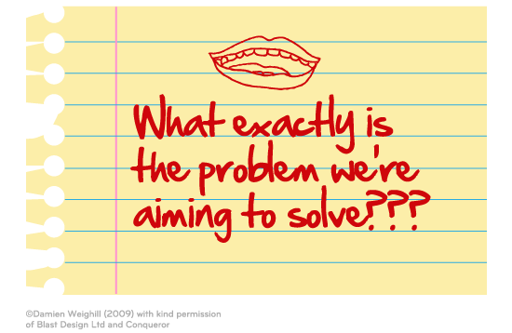
Content of a Research Proposal

Slide 8
Sell the reader the topic!
“Children with long term medical conditions are experiencing higher levels of induced cancer as a result of advances in imaging technology.”
“My dissertation is about increasing levels of induced carcinoma in children with long term conditions.”
“I am applying to XXX university to support my dissertation, which is on induced cancer in children with long term conditions.”
“Many scientists in the field of medical imaging have been debating the cause of increasing levels of induced carcinoma in children with long term conditions.”
Notes:
Consider the 4 opening statements – Only the first actually rises up to state the ISSUE–the topic at hand that precedes any and all debates or arguments or minutiae, and inspires the reader to take notice. Importantly it also presents issues of wide interest

Slide 9
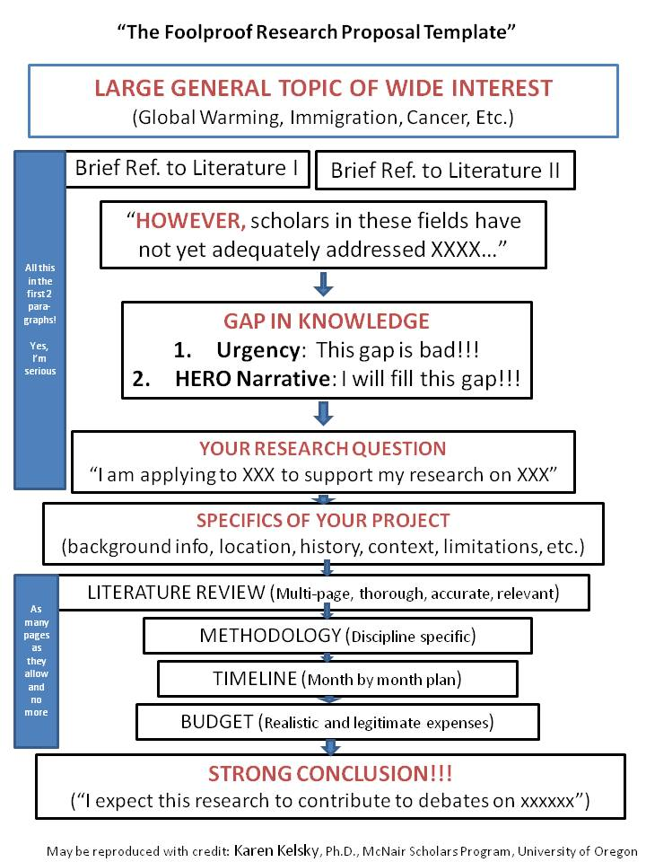

Slide 10
Large General Topic of Wide Interest
Notes:
Topics of wide interest are those that anyone, including your grandmother or someone sitting next to you on a plane, would say, “oh, yes, that’s an important topic.” Examples include: immigration, sustainable energy, changes in the family, curing cancer, new social technologies, environmental degradation, global warming, etc.
Until you can identify a really broadly interesting theme that your project relates to, you will never be successful in applying for grants.
This is because your application must *excite* the readers, and the readers are likely from a range of different disciplines. They will not all be interested in your discipline’s narrow debates. They want to know that your work and your intellectual and scholarly vision are wide, and broad, and encompassing.

Slide 11
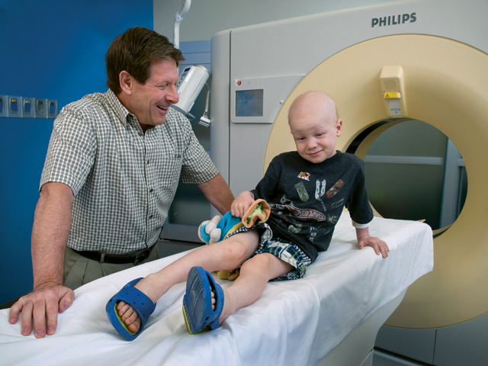
Large General Topic of Wide Interest
Notes:
Topics of wide interest are those that anyone, including your grandmother or someone sitting next to you on a plane, would say, “oh, yes, that’s an important topic.” Examples include: immigration, sustainable energy, changes in the family, curing cancer, new social technologies, environmental degradation, global warming, etc.

Slide 12
Large General Topic of Wide Interest
Your readers are likely from a range of different disciplines
Your application must *excite* these readers
They will not be aware of, or interested in, the narrow debates of your discipline - they want to know that your work and your scholarly vision for the impact of your work are wide and encompassing.

Slide 13
Notes:
Once you have established your wide, much debated, topic, you then identify two bodies of literature relevant to your own interests or discipline that have dealt with this topic.

Slide 14
childhood cancer medicine
Within oncology, leading authors (scholars) such as XX, XXX, and XXXX have all explored the value of advancing imaging technology in early diagnosis and treatment of childhood cancer and role of imaging modalities in enabling medical intervention and increasing survival rates from primary tumor occurrence.
Notes:
You can introduce this by saying “scholars in many disciplines have considered this important phenomenon.
If you are an anthropologist, and your research is on Haitian communities in New York City, for example, you will start by pointing to the wide debates on immigration in America. Then you will write, “scholars in many fields have addressed these important questions. Within cultural anthropology, scholars such as xxx, xxx, and xxx have all explored the role of cultural beliefs in shaping immigrant communities. Within Caribbean Studies, meanwhile, scholars such as xxx, xxx, and xxx have focused on the specific demographic and economic trends which have fueled outward migration.”

Slide 15
Medical Engineering
Meanwhile, leading medical engineers such as XX, XXX, and XXXX have focused on the anatomical clarity and accuracy of reconstructed CT data …….
…….HOWEVER
Notes:
The however sentences needs to be strong……it is the decider on whether the reader continues or puts you on the do not support pile!

Slide 16
Gap in Knowledge
Scholars in these fields have not reached consensus on the central question of can image quality be less than optimal and still result in a diagnostic outcome at a lower patient dose thereby decreasing risk of future cancer occurrence.

Slide 17
Notes:
Once you have established your wide, much debated, topic, you then identify two bodies of literature relevant to your own interests or discipline that have dealt with this topic.

Slide 18
Urgency
Understanding the low dose imaging threshold for answering diagnostic questions is essential if we are to ensure imaging advancements optimise patient care and limit radiation harm in the future.
Without these we are compelled to adopt ill thought through protocols designed by manufacturers without cognisance of patient risks resulting in a cycle of dissatisfaction and frustration among imaging health professionals
Notes:
XXXXXXX in this case is YOUR view of what is most essential to an accurate understanding of the big topic, but which has never to date been studied by anyone else.
This brings you to the GAP IN KNOWLEDGE: “Despite much excellent work on themes such as XXX and XXX, scholars examining the transformations in immigration in America have not yet fully explored the importance of XXXX in creating and sustaining these communities.”
Now for the URGENCY:
“Yet, without such an understanding, we are left with an inadequate analysis that creates the condition for ill-informed policy decisions and a self-sustaining cycle of misunderstanding and resentment….”
Now for the HERO NARRATIVE.

Slide 19
Hero Statement
This study will remedy this gap in the evidence base by examining the relationship between modern CT imaging scan trends and patient dose and exploring the hitherto unrecognised relationship between low dose imaging and accurate diagnostic outcomes within the emotive context of childhood cancer.
Notes:
Remember, YOU are the HERO who is going to save us from ourselves and our inadvertant but devastating ignorance about the true significance of XXX!

Slide 20
Your Research questions
I am applying to XXX to support the completion of my dissertation on XXX. Through a detailed analysis of XXX, I will demonstrate that in contrast to common held clinical and manufacturer beliefs, low dose imaging can……..XXXXXX.

Slide 21
Notes:
Once you have established your wide, much debated, topic, you then identify two bodies of literature relevant to your own interests or discipline that have dealt with this topic.

Slide 22
Specifics of the Project
Background
Literature Review
Method
Data collection
Analysis
Ethical approval
Team and skills
Timeline
Costs

Slide 23
The specifics
Background
Literature Review
Context (global, national and regional positions)
Location
History
Limitations
Explores the details introduced in statements above.
Provides a critical overview of existing literature in the field (you have read the literature haven’t you!)
Positions your work and its value and contribution

Slide 24
Method
Start with asking
“What data do I need to answer my question”
Your answer to this will often direct you to a specific methodological approach
For example:
waiting time data will lead you to a quantitative approach – numerical data
experiential narrative will lead you to a qualitative approach – narrative data

Slide 25
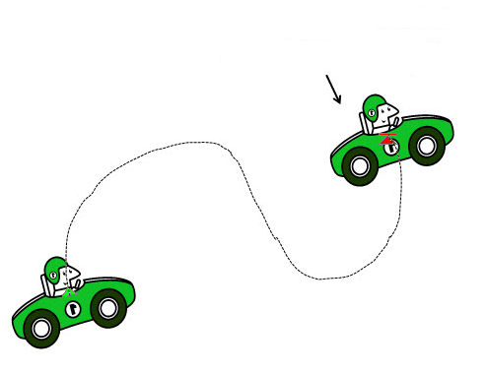
Tip 3: Know the end point before you start!
The end point

Slide 26
End Point
Type of data
How much data
Sample size
How will you collect data
I KEEP six honest serving-men (They taught me all I knew); Their names are What and Why and When And How and Where and Who. (Kipling – elephants child)
How you will analyse data

Slide 27
Tip 4: Be Clear!

Slide 28
Ethical Approval
Do you need it?
Do you know the process?
Are there other governance processes to comply with?
Do you know how long it will take?

Slide 29
The Team
Have you got people with the right skills in your team (supporting you)?
Statistician
Health economist
Research assistant
Clinical advocates
Service user
Librarian
Data manager

Slide 30
Notes:
Once you have established your wide, much debated, topic, you then identify two bodies of literature relevant to your own interests or discipline that have dealt with this topic.

Slide 31
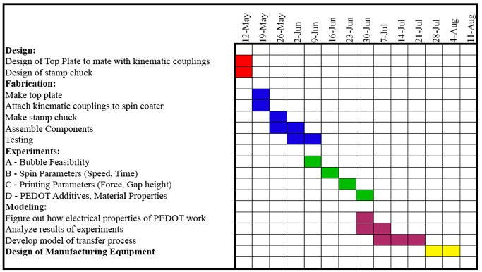
Timeline
Calculate …..then add 30%

Slide 32
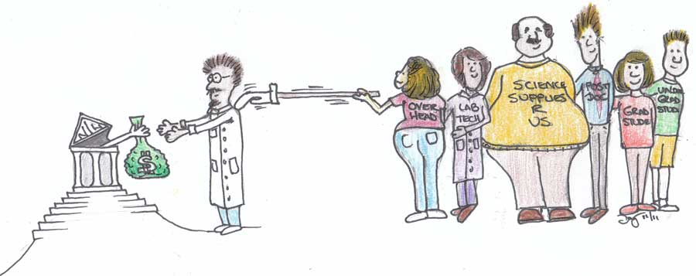
Costing Your Research
Research isn’t cheap!
Don’t forget your time!
Speak to your organisation accountant

Slide 33
Don’t forget dissemination and impact
Notes:
Once you have established your wide, much debated, topic, you then identify two bodies of literature relevant to your own interests or discipline that have dealt with this topic.

Slide 34
Dissemination

Slide 35
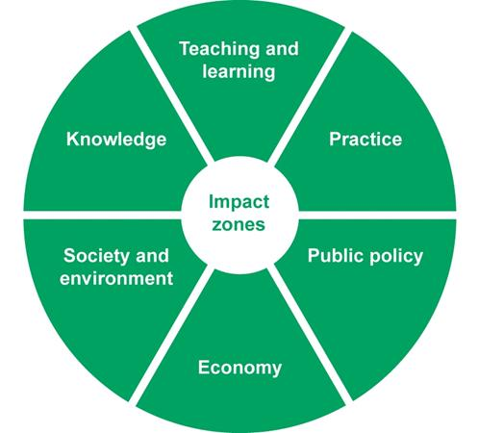
Impact

Slide 36
Notes:
Once you have established your wide, much debated, topic, you then identify two bodies of literature relevant to your own interests or discipline that have dealt with this topic.

Slide 37
The Concluding Statement
Don’t forget it!!!!
Keep it simple and focused – bring reader back to the importance of your research and its potential reach and impact
“I expect this research to contribute to debates on XXXXX and play an important role in shaping debates on XXXX and XXXX in the coming years.”
Notes:
This Conclusion demonstrates that you are a master of both the micro and the macro implications of your project. You have an unassailable timeline and budget, but you also have your eye on the wider scholarly world and your role in it.
Do all of this, my friends, and you will walk away with generous, abundant funding for your every project. You will have the leisure to do the best work, and the best work will in turn legitimize you for the next major grant for which you apply. You will be on the “GRANT GRAVY TRAIN“, and that is the key to the most successful academic careers.

Slide 38
Proposal for Research Funding
Notes:
Answer their questions – not your own
Teams are important – often looking for collaborations
Evidence of success in the team
Financial management
IMPACT

Slide 39
Tip 5: Heed my advice!

